Slide 1
GINKONet Project
(Greater Indiana, Kentucky, and Ohio Network)

Slide 2




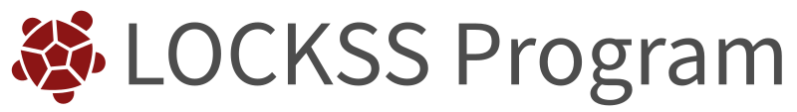
What is GINKONet
A proposed PLN for the greater Indiana, Kentucky, and Ohio region created by former MetaArchive members
The GINKONet Project was started in April 2024 when MetaArchive announced that it would be sunsetting
September 2024 applied to a IMLS Grant
November 2024 created biweekly working meetings
February 2025 coordinated with LOCKSS to begin the process of transforming the Dandelion Archive into GinkoNet
April 2025 applied to Gladys Brooke Foundation Grant

Slide 3
Project Goals
Create a sustainable, reliable, community-led, low-cost digital preservation network
Create a regional digital preservation community
Resolve some of the major issues that caused MetaArchive to fall apart
Universal Ingest plugin
Streamline governance
Reduce overhead cost

Slide 4
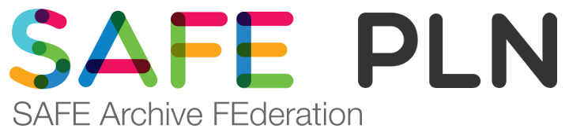
Costs
Cost are going to be similar to MetaArchive
No Educopia fees
Eliminate overhead cost
Start up Cost
Equipment
Technical Setup
Governance Setup

Slide 5
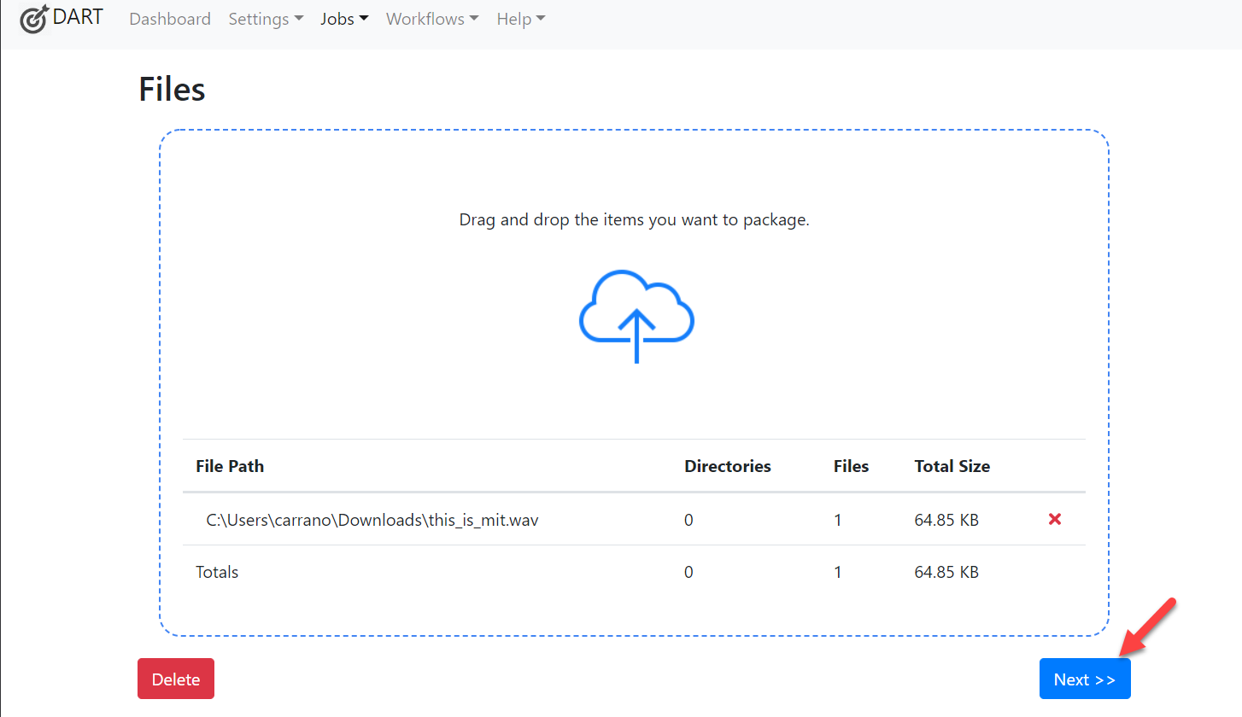
Project Timeline
2025 - Set up LOCKSS 2.0 network with existing MetaArchive equipment
2025 - Apply for additional grant funding
TBD - ingest content into network with DART or other user friendly ingest tool
TBD - Finalize governance documentation

Slide 6
Current Challenges
This project will take time to implement.
The success of GINKONet is based on the time and sweat equity people dedicate to the project.
It recommended that a LOCKSS network has 5 nodes.
Purdue, Louisville, Case Western - self host
InDiPres - node hosted by IU
Paid node - hosted by LOCKSS Program

Slide 7
Get Involved / Q&A
Current Working Group
Ben Parnin (Purdue)
Reid Boehm (Purdue)
Justin Clark (InDiPres)
Rachel Howard (Louisville)
Hannah Pryor (Louisville)
Alyssa Pierce (Case Western)
Snowden Becker (LOCKSS Program)
Thib Guicherd-Callin (LOCKSS Program)

